Slide 1
RCVMHS & WORKFORCE
Implications for Psychologists Employed in Public Mental Health
Rosemary Kelly September 2021

Slide 2
RCVMHS
The Royal Commission recognised that the mental health workforce is at the heart of Victoria’s mental health system
The workforce will be critical to achieving reform and improving the system
The key enabler will be a capable, skilled, empathetic and consumer-driven workforce

Slide 3
Workforce inhibitors recognised by the RC include
Budget constraints and limited resources
Excessive and unsustainable workloads
Burnout
Occupational violence
Vicarious trauma
Lack of career progression
Unclear accountability structures
High administrative burdens
Not being able to work to full scope of practice (eg psychologists)
Deskilling and low morale
Attraction of private practice – psychiatrists and psychologists

Slide 4
Royal Commission’s Vision for the Workforce
More people with diverse experience and expertise will join the workforce to provide new and enhanced services including services lead by people with lived experience
The workforce will receive professional and well being supports to provide high quality care in a safe and therapeutic environment
Multidisciplinary teams will share skills to respond to individuals’ needs supported by technology
The workforce will have access to a high standard of professional learning
(Final Report Vol 4 page 6, p 497))

Slide 5
What is the skill and discipline mix needed to achieve the RC’s vision?
The Royal Commission did not address the skill and discipline mix of the diverse multidisciplinary workforce it envisions
It is silent on models of care and the composition of the workforce at the level of service delivery
Particular emphasis is placed on developing the lived experience/peer workforce
Responsibility for addressing the workforce implications of the proposed reforms is handed off to the Department of Health

Slide 6
The new Mental Health and Wellbeing Division of the Department of Health has a deadline of December 2021 to develop a Workforce Strategy
The Division has established a Mental Health and Wellbeing Workforce Technical Advisory Group (WTAG) to inform this work
There are four main areas of focus:
Workforce capability framework
Workforce wellbeing
Workforce supply
Rural and regional attraction and retention
Rosemary Kelly (VPA) was invited to be a standing member of WTAG. VPA members have been involved in consultations.

Slide 7
Industrial Relations/ Employment Implications of a Restructured System
The biggest impact on the psychology workforce will be the organisational restructure with the the introduction of
Regional Mental Health and Wellbeing Boards deciding Local services
Area Mental Health and Wellbeing Services for (i) adults (ii) children, adolescents and youth with different boundaries
New Statewide Services
And the introduction of organisations providing public mental health services under contracts to regional Boards

Slide 8
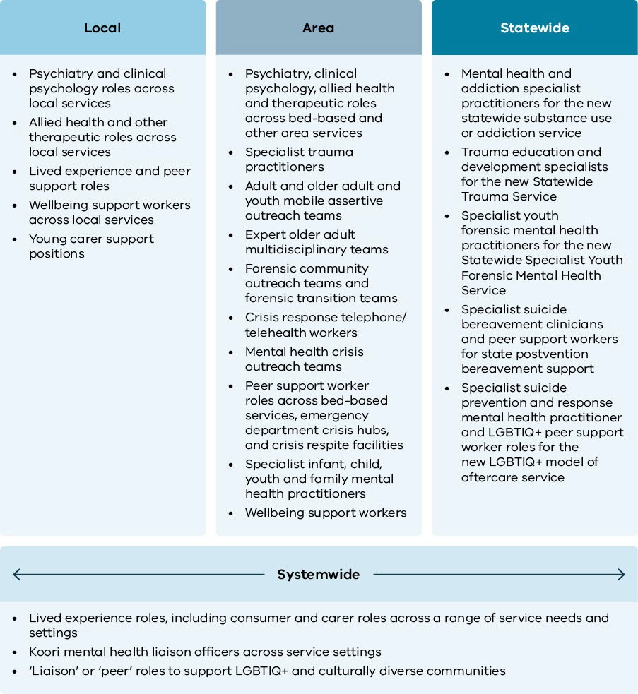
Figure 33.10: Indicative workforce supply considerations

Slide 9
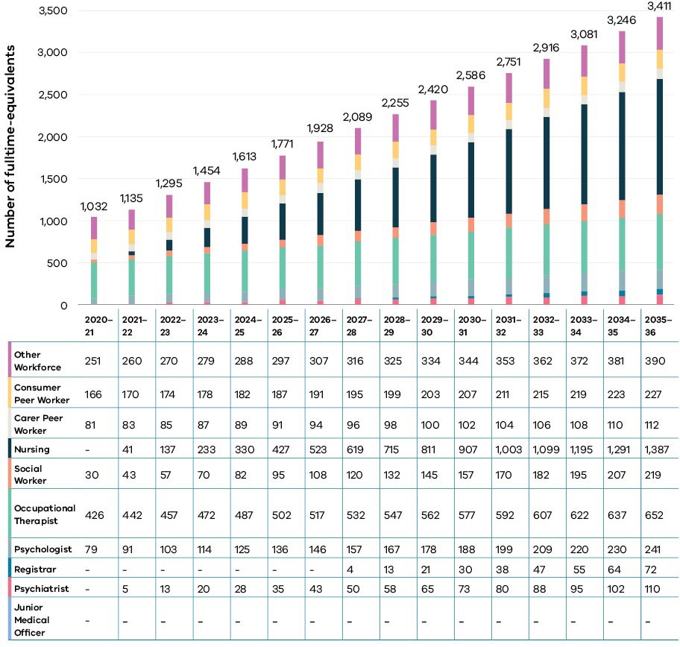
Figure 33.9: Estimated workforce supply gaps in the public specialist mental health system, by workforce discipline, Victoria, 2020–21 to 2035–36

Slide 10
Transfer of Employment Consultation Restructuring of jobs
The Royal Commission sees the current workforce working for new organisations and/or working across different geographies
Questions that arise include:
How will consultation be managed?
Will employment transfer between agencies? If so, how?
Will the public sector EBA apply to employment with another agency, service or organisation that sits outside public mental health services as currently organised?

Slide 11
Challenges and opportunities?
What does this all mean for Psychologists in Mental Health and the VPA?

